Slide 1
Functions Review
Black Box Design
Programmer-Defined Functions
Parameters in Functions
Function Call
Call-By-Reference
void Functions
Overloading Function Names
Default values

Slide 2

Functions as a black box
Input almost always in parameters
inputs
Input sometimes cin:
When function name has “read”, “get”, “input”
Function
Black box
Output almost always in return statement
outputs
Call-by-reference
Output sometimes cout:
When function name has “write”, “print”, “display”

Slide 3
Programmer-Defined Functions

Slide 4
Example: Add sales tax to bulk order
Let’s look at a program that…
Inputs an integer for the number of items e.g. 2
Inputs a decimal for the price of the item e.g. 10.10
Uses a function to calculate the total cost which adds a 5% sales tax to the order.
Lastly, the program prints…
2 items at $10.10 each.
Final bill, including tax, is $21.21

Slide 5
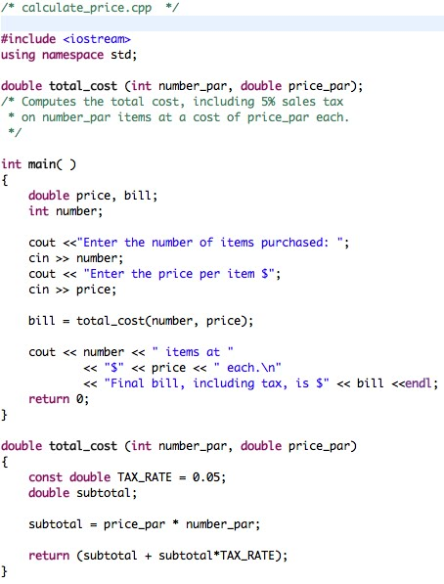
What are these called?
function declaration
(AKA prototype)
Do we need this?
What is its purpose?
Arguments
function call
Return Type
Formal Parameters
function definition AKA function implementation
function header
function body

Slide 6
Programmer-Defined Functions
Function declaration (or Function prototype)
Tells the compiler about the function and how it is called.
Must be declared before the function can be called.
Syntax:
Type_returned Function_Name(Parameter_List); //Comment describing what function does
Function definition (or Function implementation)
Tells the compiler how the function does its task
Can appear before or after the function is called
Syntax:
// Comment describing preconditions/postcondition Type_returned Function_Name(Parameter_List) { //code to make the function work }
;

Slide 7
Function Call
Tells the name of the function to use
Lists the arguments
Is used in a statement where the return value makes sense
Example: total_cost(number, price) is the function call double bill = total_cost(number, price);

Slide 8
Function Call Details
The values of the arguments are plugged into the formal parameters (Call-by-Value mechanism with call-by-value parameters)
Left to right order…
The first argument is copied to the first parameter, the second argument copied to the second parameter, etc.
The value plugged into the formal parameter is used in all instances of the formal parameter in the function body

Slide 9
Trace the code
What happens?
2
10.10
int number_par = 2
double price_par = 10.10

Slide 10
number_par set to 2 price_par set to 10.10
So
subtotal = 20.20
Returns:
(subtotal + subtotal * TAX_RATE) =
(20.20+20.20*0.05) or 21.21.

Slide 11
21.21 is returned to where the function was called.
total_cost (number, price) is replaced by the return value of 21.21
So bill = 21.21

Slide 12
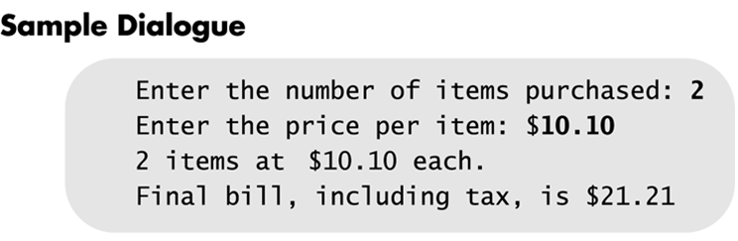

Slide 13
Function Specifics

Slide 14
Declare before you Use
In C++, everything must be declared before used.
#include <iostream> declares cin and cout and their classes (istream and ostream) before anything else.
The compiler uses declarations (prototypes) to ensure identifiers are being used correctly.

Slide 15
Placing Prototypes & Definitions
Place the function prototypes above the main function.
In C++, you must declare it before you use it.
Place the function definitions below the main function.
Doing this leads to building your own libraries!
No declaration is needed if the definition comes first.

Slide 16
Function Declarations
List formal parameter names
Description of the function in comments
Example:
double total_cost(int number_par, double price_par); // number_par is the number of items and is a parameter
// price_par is the price each – and is a parameter

Slide 17
Automatic Type Conversion
Given the definition double mpg(double miles, double gallons) { return (miles / gallons); } what will happen if mpg is called in this way? cout << mpg(45, 2) << “ miles per gallon”;
The values of the arguments will automatically be converted to type double (45.0 and 2.0)

Slide 18
About Sales Tax
You buy stuff
Most stuff is taxable (not milk, eggs.. Basics)
Assume we only buy taxable stuff
TotalPriceForStuff = 100 // AKA SubTotal
TaxRate = .05; // 5%
TaxPaid = TaxRate * TotalPriceForStuff;
TotalWePay = TotalPriceForStuff + TaxPaid;

Slide 19
Function Definition Syntax
within a function definition …
Variables must always be declared before they are used
Variables are typically declared before the executable statements begin
double total_cost(int number_par, double price_par) { const double TAX_RATE = 0.05; //5% tax double subtotal; subtotal = price_par * number_par; return (subtotal + subtotal * TAX_RATE); }
At least one return statement must end the function when not void.
Each branch of an if-else statement or a switch statement might have its own return statement

Slide 20
Formal Parameter Names
Functions are designed as self-contained modules
Programmers choose meaningful names for formal parameters
Formal parameter names may or may not match variable names used in the main part of the program
It does not matter if formal parameter names match other variable names in the program
Remember that only the value of the argument is plugged into the formal parameter

Slide 21
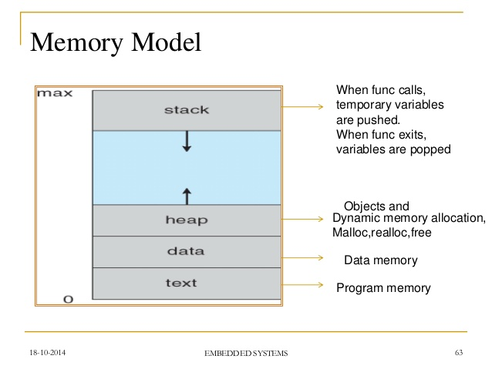
Program in memory
Arguments are pushed onto
the stack as parameters
when a function is called.
Local variables are created
on the stack and popped (removed) on return.
Dynamic Memory
Allocation (discuss later)
Global variables
Program code

Slide 22
Function call:
What’s really happening

Slide 23
When a Function is called
the arguments are copied (in order) into the parameters (on the stack)
the return address must be saved
the code jumps to function which uses the parameters set to the argument values
local variables may be declared, function statements execute sequentially
return statement may shorten execution.

Slide 24
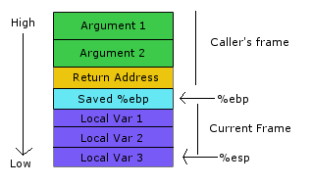
Function Stack
Stack grows from highest memory address to lowest.
Function caller puts arguments on stack into the parameters.
System puts return address, then jumps into the function.
Local variables get created on the stack next!
ebp - points to beginning of previous frame (base pointer)
esp – next stack position.
Arguments are pushed onto stack in order they appear.
Return address is pushed on before the call is made.
Local variables are pushed onto stack in order they appear.

Slide 25
Stack for main
price | 10.10
bill
number | 2
price | 10.10
bill | 21.21
number | 2
Stack for total_cost
number_par | 2
price_par | 10.10
return address | Line 19, =
TAX_RATE
subtotal
number_par | 2
price_par
return address
TAX_RATE
subtotal
number_par | 2
price_par | 10.10
return address | Line 19, =
TAX_RATE | .05
subtotal
number_par | 2
price_par | 10.10
return address | Line 19, =
TAX_RATE | .05
subtotal | 20.20
number_par
price_par
return address
TAX_RATE
subtotal

Slide 26
Reality: One Big Stack
Stack
Stack for main starts here
price | 10.10
bill
number | 2
price | 10.10
bill | 21.21
number | 2
Stack for total_cost starts here
number_par | 2
price_par | 10.10
return address | Line 19, =
TAX_RATE
subtotal
number_par | 2
price_par
return address
TAX_RATE
subtotal
number_par | 2
price_par | 10.10
return address | Line 19, =
TAX_RATE | .05
subtotal
number_par | 2
price_par | 10.10
return address | Line 19, =
TAX_RATE | .05
subtotal | 20.20
number_par
price_par
return address
TAX_RATE
subtotal
Stack for total_cost ends here

Slide 27
Quick review questions
What is the syntax for a function declaration?
What is the syntax for a function definition?
What is the syntax of a function call?
What happens when the following line of code is executed in the example program:
bill = total_cost(10, 35.50);
bill = total_cost(2.5, 30);

Slide 28
Up Next:
Scope
Binary
Addresses
Pass by value
Pass-by-reference
Swap

Slide 29
Outline
Variables inside Memory
Call-by-value and Call-by-reference
Overloading
Default parameter values

Slide 30
Variable scope
Remember: What's defined in the function stays in the function.
(Just like blocks { } )
Variables declared in a function
are local to that function
are invisible to all other functions
int main() is a function

Slide 31
What does this code do?
int newFunc(int a);
int main() {
int a=5, b, c=5;
b = newFunc(a);
cout << a << " " << b << " “ << c ;
cout << endl;
return 0;
}
int newFunc(int a) {
int c=12;
return a*5+c;
}

Slide 32
Formal parameter names
Typically, argument names do not match parameter names
Example declaration:
int mymin(int oneNum, int anotherNum);
..
Example call:
int x=6; int y=4;
mymin(x,y);

Slide 33
Formal parameters
Which are the Formal Parameters?
float triple(float inNum)
{
float tripledNum;
tripledNum=3*inNum;
return tripledNum;
}

Slide 34
Formal parameters - reminders
Local to the function
Used as if they were declared in function body – so … do not re-declare in function body
When function is called, parameters initialized to the values of the arguments in the function call
float triple(float inNum)
{
float tripledNum;
tripledNum=3*inNum;
return tripledNum;
}
Draw the stack!

Slide 35
Storage of Variables

Slide 36
Binary representation
Each variable is represented by a certain number of 0s and 1s
Each 0-or-1 is a bit
8 bits in a row is a byte
int numStudents = 33;
assigns a binary code to memory: 00000000000000000000000000100001

Slide 37
Variable types, revisited
char | single character ('a', ‘M’). See ASCII table | 1 byte
int | integers (-4, 82) | 4 bytes
bool | logic (true or false) | 1 byte
float | real numbers (1.3, -0.45) | 4 bytes
string | text ("Hello", "reload") | ? Bytes
double | Twice the precision of float (more digits to right of decimal) | 8 bytes

Slide 38
Quick Code – sizeof.cpp
Try vi
== 5==
>> <<
>iB
commands
Copy and Run!
int i;
float f;
double d;
char c;
bool b;
cout << "size of integer is " << sizeof(i) << endl;
cout << "size of float is " << sizeof(f) << endl;
cout << "size of double is " << sizeof (d) << endl;
cout << "size of char is " << sizeof(c) << endl;
cout << "size of bool is " << sizeof(b) << endl;

Slide 39
How many bit are each of these?
size of integer is 4
size of float is 4
size of double is 8
size of char is 1
size of bool is 1

Slide 40
Simple Code
#include <iostream>
using namespace std;
main( ) {
int numStudents;
cout << "How many students in the class?";
cin >> numStudents;
}

Slide 41
Variables – stored at addresses (locations) in memory
Each variable indicates a location in memory
Each location holds a value
Value can change as program progresses
Variables
Address₁₀ Value
x
04902340 00000001 04902348 00010110
04902356 11011101
04902364 01010000
04902372 00101100
04902380 11011110
04902388 01000110
1 or true
numStudents
(in main)
22
i
?
Notes:
Different variable types take up different amounts of memory

Slide 42
Memory usage by functions
“Call-by-value”:
provide function with the value held in a variable input
assign value to new internal variable
Variables
Address₁₀ Value
x
04902340 00000001 04902348 00010110
04902356 11011101
04902364 01010000
04902372 00101100
04902380 11011110
04902388 01000110
numStudents
(in main)
22
i
Notes:
Different variable types take up different amounts of memory

Slide 43
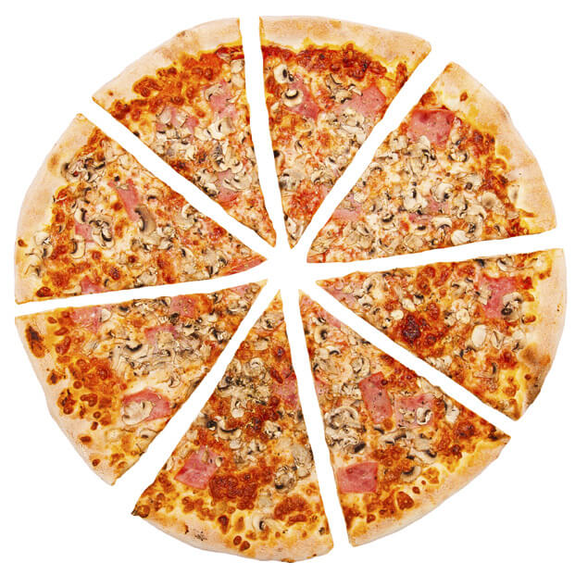
Let's Order Pizza
But how many?
Depends how many people we have
Make a function to figure it out

Slide 44
1 Input Parameter, 1 return value
int numLgPizzaToOrder (int numPeople)
{
/* algorithm (formula) is from many years of experience. */
const int slicesPerPerson =3;
int nPizzas;
nPizzas = ceil(numPeople * slicesPerPerson / 8);
return(nPizzas);
}

Slide 45
Memory usage by functions
2 styles: “Call-by-value” & "Call-by-Reference"
Variables
Address Value
x
04902340 00000001 04902348 00010110
04902356 11011101
04902364 01010000
04902372 00101100
04902380 11011110
04902388 01010000
numStudents
(in main)
i
Notes:
Different variable types take up different amounts of memory

Slide 46
“Call-by-value”:
provide function with the value held in a variable input
Copies the value to new internal variable
Variables
Address Value
04902340 … 00000001 04902348 … 00010110
04902356 … 11011101
04902364 … 01010000
04902372 … 00100110
04902380 … 11011110
04902388 … 00010110
numStudents
(in main)
Copies the Value to an address used by the function.
numPeople
(in function numLgPizzaToOrder)
Notes:
Different variable types take up different amounts of memory

Slide 47
“Call-by-value”
ERASES the local value when leaving the function.
Why? The variable is 'out of scope' & gone
Variables
Address Value
04902340 … 00000001 04902348 … 00010110
04902356 … 11011101
04902364 … 01010000
04902372 … 00100110
04902380 … 11011110
04902388 … 00010110
numStudents
(in main)
Copies the Value to an address used by the function.
numPeople
(in function numLgPizzaToOrder)
Notes:
Different variable types take up different amounts of memory

Slide 48
“Call-by-reference”
Does not copy
Sends the ADDRESS of the original variable
Allows you to change the value of the original variable
Variables
Address Value
04902340 … 00000001 04902348 … 00010110
04902356 … 11011101
04902364 … 01010000
04902372 … 00100110
04902380 … 11011110
04902388 … 00010110
numStudents
(in main)
numPeople
(in function numLgPizzaToOrder)
Notes:
Different variable types take up different amounts of memory

Slide 49
Address Of
&
Notice that:
address of numPeople = address of numStudents
Variables
Address Value
04902340 … 00000001 04902348 … 00010110
04902356 … 11011101
04902364 … 01010000
04902372 … 00100110
04902380 … 11011110
04902388 … 00010110
numStudents
(in main)
numPeople
(in function numLgPizzaToOrder)
Notes:
Different variable types take up different amounts of memory

Slide 50
Call-by-Reference Syntax
Use & to indicate a variable called by reference
Use & both in declaration and definition
Why? For the declaration (AKA prototype) you just copy the definition header and add a ;
& can be located anywhere between the type and variable

Slide 51
Call-by-Reference Example
Declaration (top of file). Matches definition,but add ;
void get_letters(char& letter1, char& letter2);
Definition (preferably above main)
void get_letters(char& letter1, char& letter2)
{
cout << "Enter two letters: ";
cin >> letter1 >> letter2;
}
Calling the function
main()
{
char a,b;
get_letters(a,b);
cout << "After get_letters " ;
cout << "a= " << a << " b= " << b<< endl;
}

Slide 52
Call-by-reference vs. Call-by-value
Call-by-value preserves the value of the original input argument
Call-by-reference can change the value of the original input argument
Effectively allows return of multiple values from function

Slide 53
What does this do?
int mysteryFunc(int& num1);
int main()
{
int a=5;
cout << mysteryFunc(a) << endl;
cout << a << endl;
return 0;
}
int mysteryFunc(int &num1)
{
num1 += 3;
return num1/4;
}

Slide 54
What does this do?
int mysteryFunc2(int inNum);
int main()
{
int a=3;
cout << mysteryFunc2(a);
cout << a;
return 0;
}
int mysteryFunc2(int inNum)
{
inNum = inNum*6;
return inNum;
}

Slide 55
Call-by-reference: Input arguments
Arguments must be variables
If declaration is:
void myFunc(float& inputNum);
Good call:
float inputVariable =25.4;
myFunc(inputVariable);

Slide 56
Build it live: write 3 functions that
Read 2 integers
Swap their values:
If a =2 and b=3 then the result should be
a=3 and b=2
Print the two values
Do we need to build them in the order we use them?

Slide 57
Swap Part 1: Input
Write a function Get2Ints to read 2 integers:
What should the definition look like?

Slide 58
Swap Part 2. Print
Write a function Print2Ints to print 2 integers:
What should the definition look like?

Slide 59
Swap Part 3. Swap
Write a function Swap that will swap the values of 2 integers.
name the values val1 and val2;
Even though you might have forgotten how to write the code ..
Can you write the stub ?

Slide 60
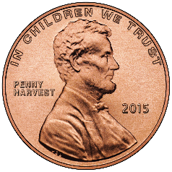
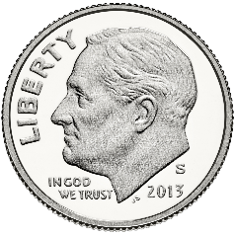
How to Swap? A Printout
Start like this:
End like this:
Rule: 1 coin per box
What to do?

Slide 61
Swap Lab Part 3
1) Write a function swap which swaps two integers
How to swap:
Requires an extra 'Temp' variable of the same type.
Example: Suppose you have two variables x and y and you want to swap their values. Let X=10 and Y=20 to start.
X=10
Temp
Y=20

Slide 62
How To Swap
Step 1:
Assign the value of X to Temp
X=10
Temp=10
Y=20
Temp = X;

Slide 63
How To Swap
Step 2:
Assign the value of Y to X
X=20
Temp=10
Y=20
X = Y;

Slide 64
How To Swap
Step 3:
Assign the value of Temp (10, the old X)
to Y
X=20
Temp=10
Y=10
Y = Temp;
Now X=20 and Y=10

Slide 65
Swap
Add code to do the swap

Slide 66
Swap Lab. Design
From main :
Could you write the code for Get2Ints and Print2Ints and the code for Swap in one big main() file and get the same answer?
Sure!
But we won't.. ☺

Slide 67
Addresses: More usage of &
int x = 5;
int& y=x; // y and x point to same address
y=10;
cout << x << endl; // output x value
cout << &x << endl; // output x address
cout << y << endl; // output y value
cout << &y << endl; // output y address

Slide 68
Choosing Parameter Types
How do you decide whether to use a call-by-reference or call-by-value formal parameter?
Ask yourself:
Does the function need to change the value of the variable used as an argument?
Yes? Use a call-by-reference formal parameter
No? Use a call-by-value formal parameter

Slide 69
Mixed Parameter Lists
Call-by-value and call-by-reference parameters can be mixed in the same function
Example, consider the following function declaration void good_stuff(int& par1, int par2, double& par3);
par1 and par3 are call-by-reference formal parameters
Changes in par1 and par3 are the changes made on the corresponding argument variables during function call.
par2 is a call-by-value formal parameter
Changes in par2 do not change the argument variable during function call

Slide 70
Scope
Surprise! The Stack Makes this Happen

Slide 71
Local variables in a function
Variables declared in a function:
Are local to that function, i.e., they cannot be used from outside the function
Have the function as their scope
Variables declared in the main function of a program:
Are local to the main function of the program, they cannot be used from outside the main part
Have the main part as their scope

Slide 72
Block Scope
Local and global variables conform to the rules of Block Scope
The code block, generally specified by the { },
where an identifier like a variable is declared.
It determines the scope of the identifier.
Blocks can be nested
When leaving the block, local variables are erased(from the stack)

Slide 73
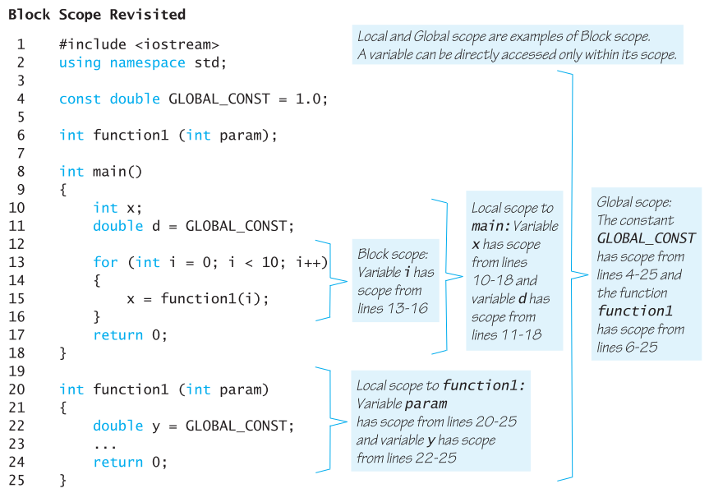
Draw the stack
A variable can be directly accessed only within its scope.
Local and Global scopes are examples of Block Scope.

Slide 74
Code design

Slide 75
Example:
Let’s look at a program that calculates a grade
Grade is computed from 3 exams. The minimum grade is tossed and the average of the 2 is the final grade (simplified for class).
Let’s decompose using stepwise refinement
Reads in three letter grades (can be A, B, C, D, F)
Converts letter grades to numbers (4, 3, 2, 1, 0)
Finds the minimum grade and tosses it.
Takes the average
Converts average back to letter grade

Slide 76
Now that we have the logic
Let’s start a program and stub it out
Where are the functions?
Reads in 3 letter grades (A, B, C, D, F)
Convert letter grades to numbers (4, 3, 2, 1, 0)
Finds the minimum grade and tosses it.
2 functions: 1) one for the sum; 2) the other for the min
Takes the average
Converts average back to letter grade
Note: A more general solution would be to use arrays!

Slide 77
Functions – what’s needed?
float convert2number(string grade);
// Converts letter grade to numeric grade
string convert2letter(float grade);
// Converts numeric grade to letter grade
void getGrades(string& g1,string& g2,string& g3);
// returns 3 letter grades, generalize to array
float calcTotal(float gr1, float gr2, float gr3);
// Calculates total, generalize to array.
float min(float gr1, float gr2, float gr3);
// returns the minimum value, generalize to array.

Slide 78
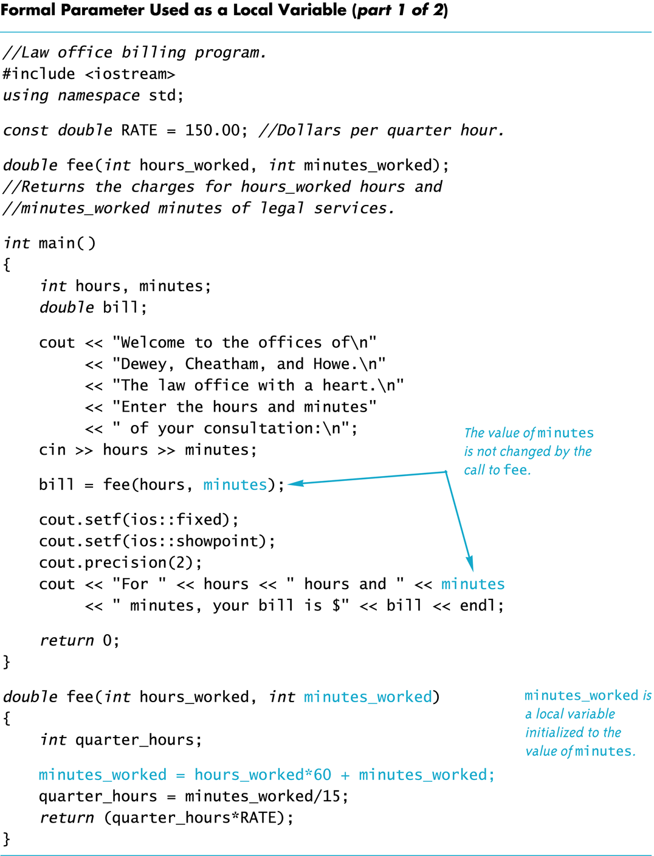
Another example
*

Slide 79
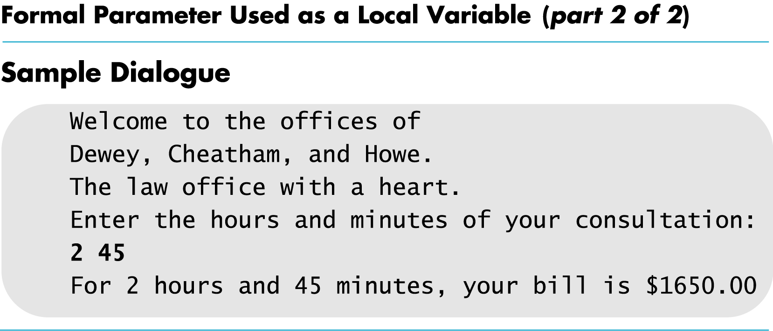

Slide 80
Default Values in Functions

Slide 81
Default Arguments
A Default argument is an argument that is passed automatically to a parameter if the argument is missing on the function call.
Must be constant set in declared prototype:
int max(int val1, int val2, int val3=0);
Can be declared in header if no prototype
Multi-parameter functions may have default arguments for some or all of them:
int getSum(int n1, int n2=0, int n3=0);

Slide 82
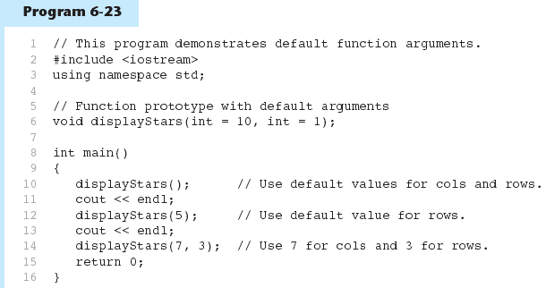
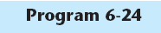
Default Arguments in Program
Default arguments are specified in the prototype
( int cols = 10, int rows = 1);
(Program Continues)

Slide 83
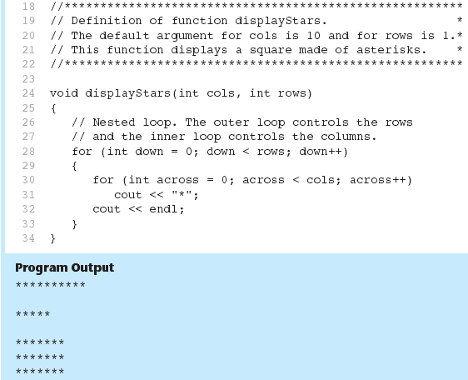
Default Arguments in Program
Default arguments are not specified
in the header

Slide 84
Default Arguments
If not all parameters to a function have default values, the defaultless ones are declared first in the parameter list:
int getSum(int n1,int n2=0, int n3=0);// OK
int getSum(int n1,int n2=0, int n3); // NO
When an argument is omitted from a function call, all arguments after it must also be omitted:
sum = getSum(n1, n2); // OK
sum = getSum(n1, n3); // NO

Slide 85
Overloading Function Names

Slide 86
Overloading Function Names
Overloading a function name means
providing more than one declaration and definition using the same function name
C++ allows more than one definition for the same function name
Very convenient for situations in which the “same” function is needed for different numbers or types of arguments

Slide 87
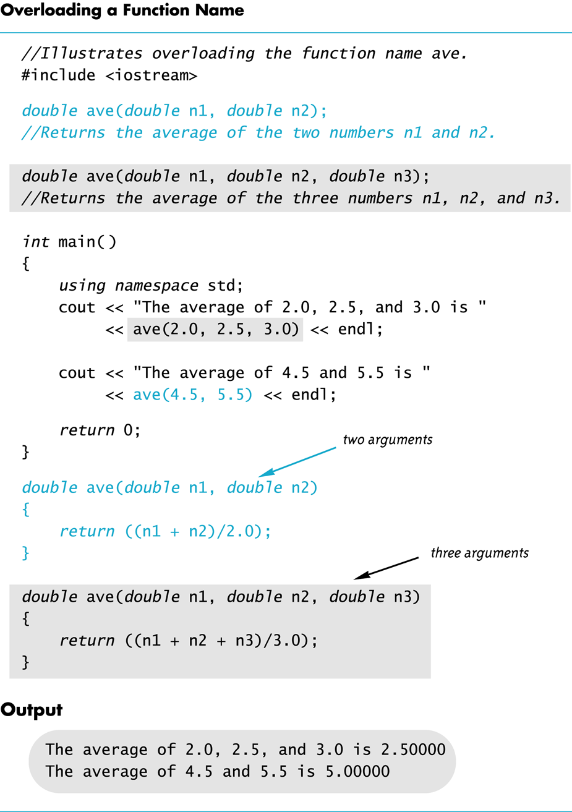

Slide 88
Overloading Examples
double ave(double n1, double n2) { return ((n1 + n2) / 2); }
double ave(double n1, double n2, double n3) { return (( n1 + n2 + n3) / 3); }
Compiler checks the number and types of arguments in the function call to decide which function to use cout << ave( 10, 20, 30); uses the second definition

Slide 89
Overloading Key points
Overloaded functions
must have different numbers of parameters OR
must have at least one different type of parameter
However…
do not have to return values of the same type.

Slide 90
Program Tracing

Slide 91
Program Tracing functions
void Sum(int a, int b, int & c)
{
a = b + c;
b = a + c;
c = a + b;
}
int main() {
int x=2, y=3;
Sum(x, y, y);
cout << x << " " << y << endl;
return 0;
}

Slide 92
Program Tracing functions
void Mystery(int & a, int & b, int c)
{
c = b + a;
a = c - a;
b = c - b;
}
void Print() {
int x = 0, y = 1, z = 2;
Mystery(x, y, z);
cout << x << “ “ << y << “ “ << z;
Mystery(x, y, z);
cout << x << “ “ << y << “ “ << z << endl;
}

Slide 93
Code Design
Stubs and Drivers

Slide 94
Use Pseudocode
Pseudocode is a mixture of English and the programming language in use
Pseudocode simplifies algorithm design by allowing you to ignore the specific syntax of the programming language as you work out the details of the algorithm
If the step is obvious, use C++
If the step is difficult to express in C++, use English

Slide 95
Program Testing
Programs that compile and run can still produce errors
Testing increases confidence that the program works correctly
Run the program with data that has known output
You may have determined this output with pencil and paper or a calculator
Run the program on several different sets of data
Your first set of data may produce correct results in spite of a logical error in the code
Remember the integer division problem? If there is no fractional remainder, integer division will give apparently correct results

Slide 96
Stubs and Drivers
Useful for testing and debugging program and function logic and design
Stub: A dummy function used in place of an actual function
Usually displays a message indicating it was called. May also display parameters
Driver: A function that tests another function by calling it
Various arguments are passed and return values are tested

Slide 97
Recursion
CISC 1600
Dr. Karen Trovato

Slide 98

Recursion
When a function calls itself:
Can be a simpler way to write a loop
Can be used as a 'divide-and-conquer' method

Slide 99

Matroshka dolls

Slide 100
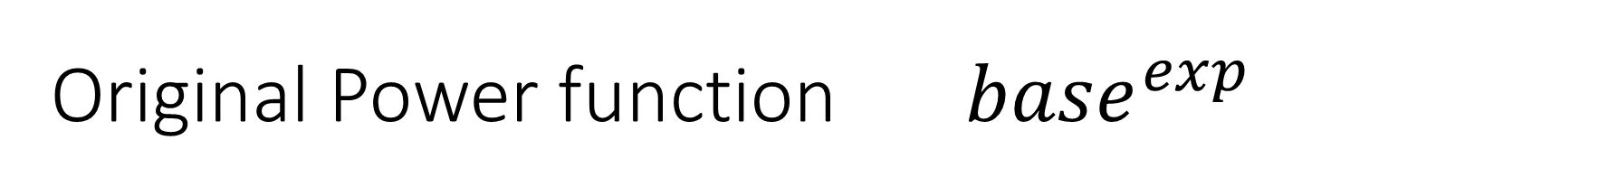
Original Power function ${ base}^{exp}$
int power(int base, int exponent) {
int result = 1;
for (int i = 1; i <= exponent; i++) {
result = result * base;
}
return(result); // if exp == 0, we can just return 1
}

Slide 101
Recursive function design
Must have:
Stopping case, sometimes called 'base case'
Simplified recursive calls – each new call must bring us closer to reaching base case(s)

Slide 102
Power calculation, another way to look at it
2 ⁵ = 2 * 2 * 2 * 2 * 2
We can also say 2 ⁵ =
2 * 2 ⁴
And we know:
2 ⁰ = 1

Slide 103
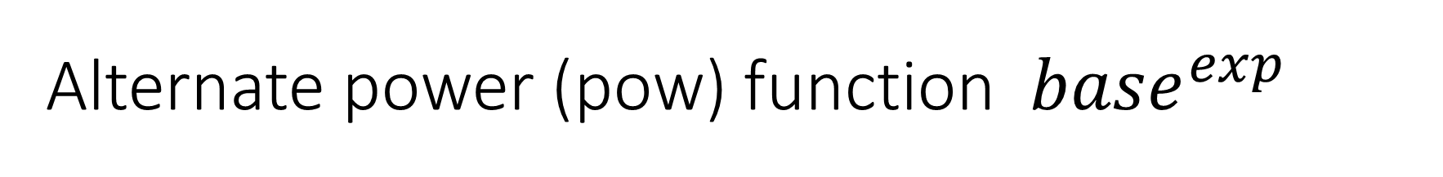
Alternate power (pow) function ${base}^{exp}$
int power(int base, int expon)
{
if(expon>0)
return (base * power(base,expon-1));
else
return 1;
// any base with 0 as exponent = 1
}
Recursive case
Stop (base) case

Slide 104
Factorial (N!)
Example:
5! = 5*4*3*2*1
So…
N! = N*(N-1)*(N-2)… *(1)

Slide 105
Basic Factorial Code
int fact (int x) {
int result = 1;
for (int i = x; i > 1; i--)
result *= i;
return(result);
}
// example for x = 5: 5*4*3*2
Define a base and incremental part of the recursive code

Slide 106
Factorial (N!) – Recursive style
Recursive case:
N*Factorial(N-1)
Base case?
1! equals 1
When N=1, stop multiplying!

Slide 107
Put them together to get:
int fact(int n)
{
if(n == 1)
return(1);
else // not really needed
return(n*fact(n-1));
}
main()
{
int num = 5;
cout << num;
cout << " factorial = " ;
cout << fact(num);
cout << endl;
}
5 factorial = 120
Stop(base) case
Recursive case

Slide 108
2) What does this code produce if the user enters 4?
int funcC(int a);
int main() {
int a;
cout << "Enter a number: ";
cin >> a;
cout << funcC(a);
return 0;
}
int funcC(int b) {
if(b==0)
return b;
else
return b + funcC(b-1);
}
1) Identify the key parts of the recursive function

Slide 109
Recursion efficiency
Reality:
Function calls are 'expensive' (take more time)
When a simple function can be performed with a loop
Use the loop

Slide 110
When is Recursion really 'worth it' ?
When you are in more advanced courses
But, you should know how it works
And be able to build simple recursive functions.
Some in examples where it is used (Not on the final, but For Your Curiosity)
A glimpse into more advanced topics

Slide 111
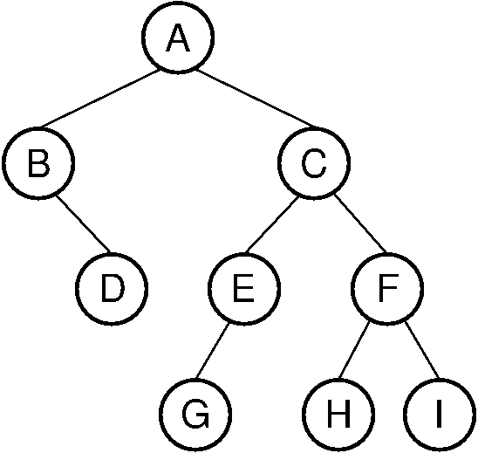
When is Recursion 'worth it' ?
Tree Traversal (visit all the nodes in this 'tree')
void preorder(BinNode rt) {
if (rt == null)
return; // Empty subtree - do nothing
visit(rt); // Process (e.g. print) root node
preorder(rt.left()); // Process all nodes in left
preorder(rt.right()); // Process all nodes in right
}
Even though you can hardly read this code now, you can still tell it is recursive

Slide 112
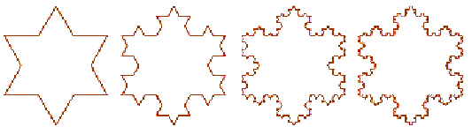
Fractals
Koch Snowflake
A fractal is a never-ending pattern that repeats itself at different scales.
This property is called “Self-Similarity.”
Fractals are extremely complex, sometimes infinitely complex - meaning you
can zoom in and find the same shapes forever.
Amazingly, fractals are extremely simple to make.
A fractal is made by repeating a simple process again and again.

Slide 113
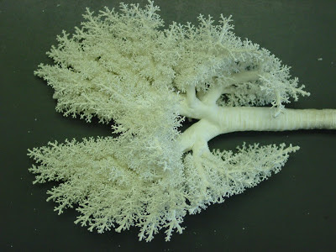
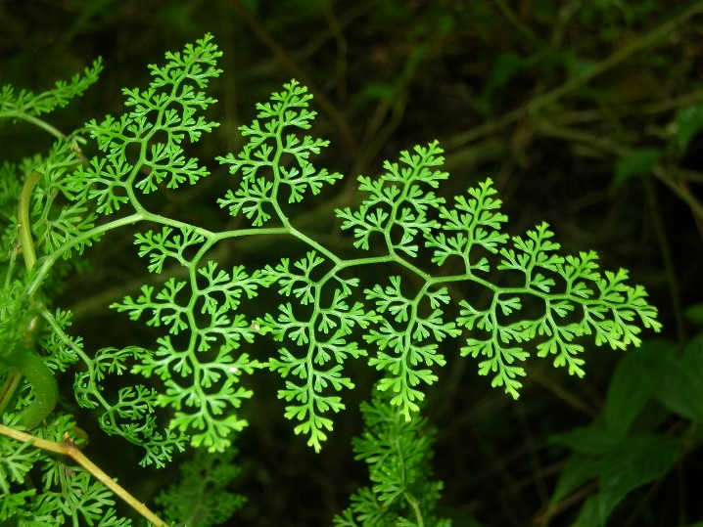
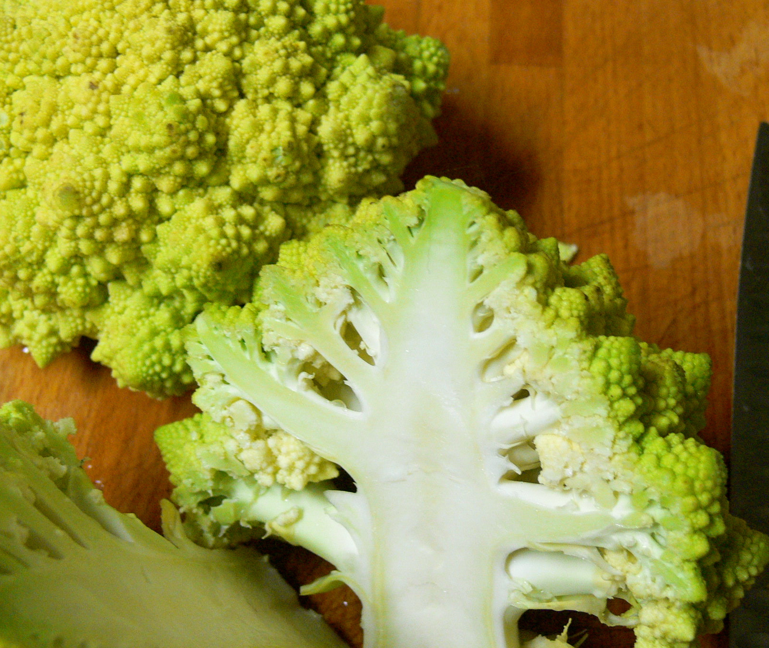

Fractals occur in Nature

Slide 114
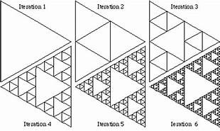
Fractals - Geometry. Sierpinski Triangle
Make an equilateral Triangle
drawAtriangle( )
{
If connecting-lines smaller than X
return;
Make 4 triangles by connecting lines from adjacent sides
For each outer triangle, drawAtriangle( )
}
Sierpinski triangle You decide when to stop

Slide 115
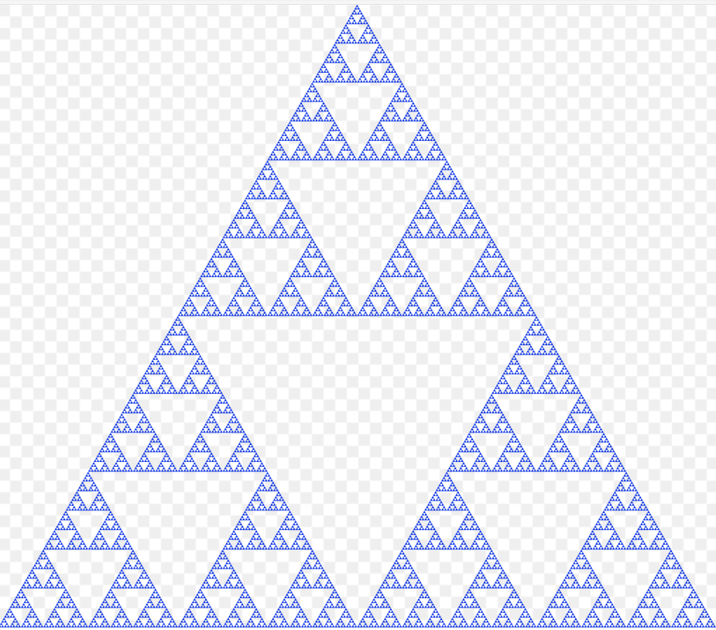
Fractals - Geometry. Sierpinski Triangle
Colorize: Alternate fill colors
Left:
By Beojan Stanislaus, CC BY-SA 3.0, https://commons.wikimedia.org/w/index.php?curid=8862246

